Slide 1
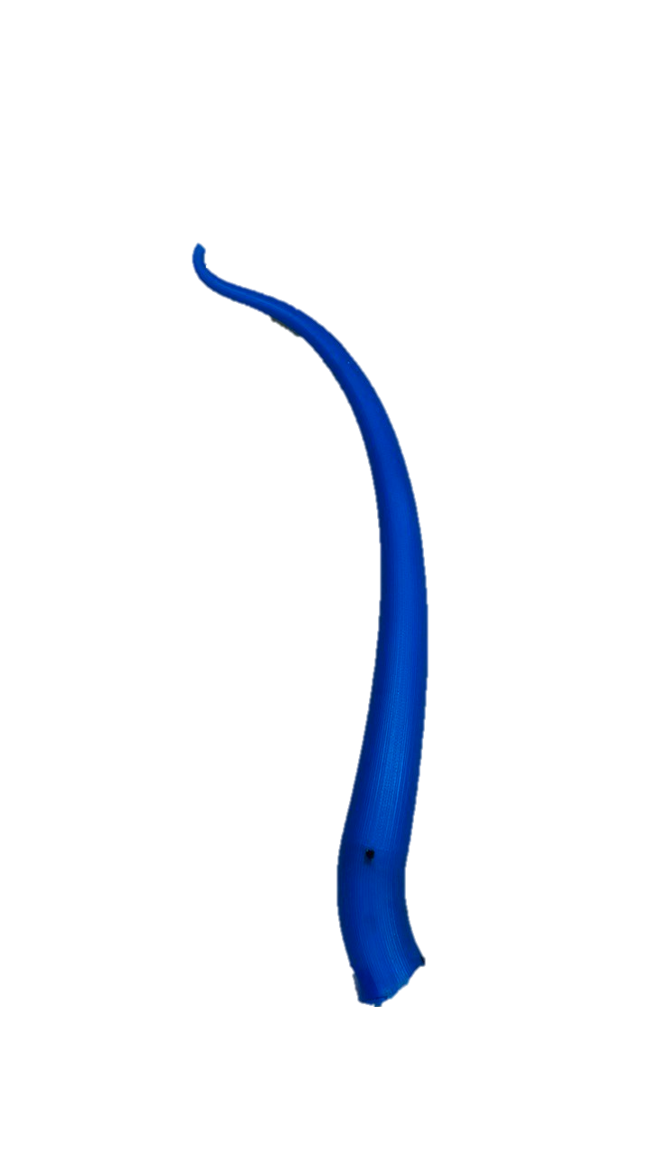
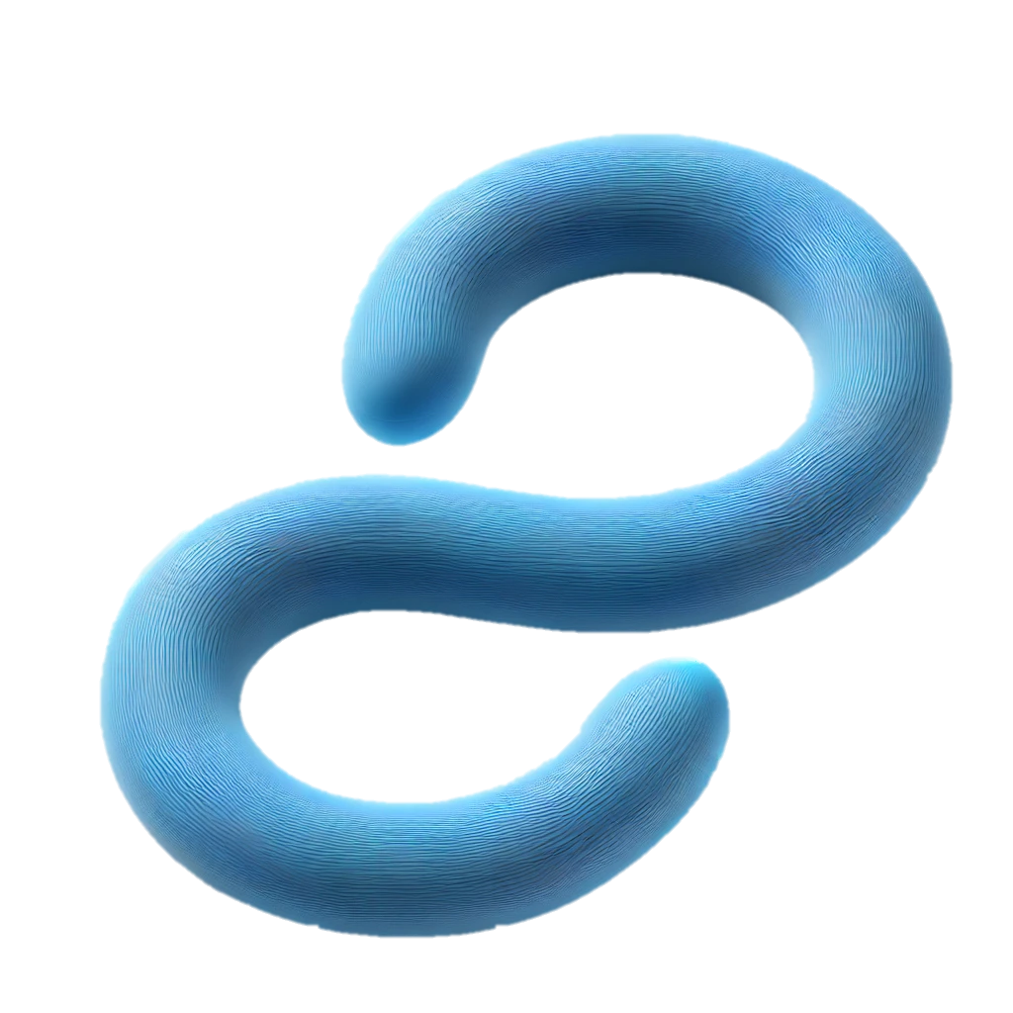
Flexible Link Motion Tracking and Velocity Estimation
ECCE 756 Robotics Perception
Presented By: Aamna Alshehhi 100062675
Presented to Prof Jorge Dias

Slide 2
Outline
Introduction
01
Project Overview
02
Pipeline Details
03
Results
04
Challenges
05
Future Work
06
Conclusion
07
Notes:
The presentation covers introduction, project overview, pipeline details, results, challenges, future work, and conclusion.

Slide 3
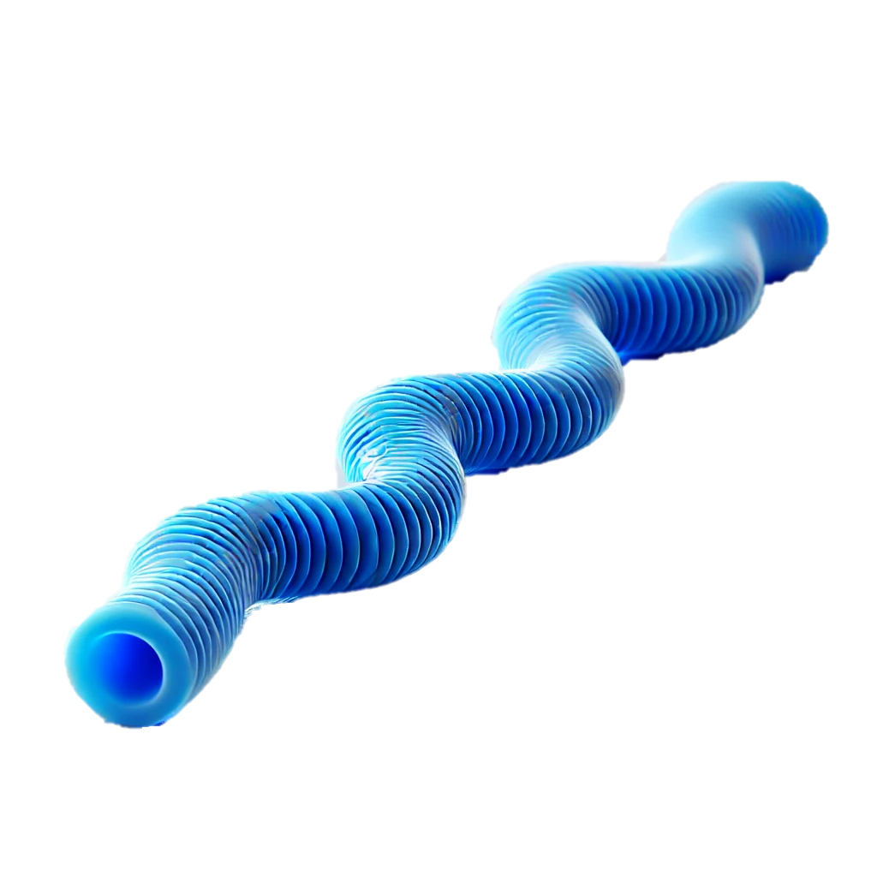
Introduction
Problem Statement:
Challenges in accurately tracking and estimating the motion of flexible links from DVS video.
Goals:
Track the motion of a flexible link.
Estimate velocities at specific points along the link.
Provide a visual representation of the link and velocities.
Notes:
Many robotic applications involve flexible links, such as robotic arms or soft robots. Accurately tracking and estimating their motion, however, presents a significant challenge. The flexibility leads to complex deformations, making traditional tracking methods insufficient. this project directly addresses this. the specific goals were : precisely track the link’s two-dimensional movement; accurately estimate velocities at multiple points along its length – allowing us to understand the movement, and create clear and informative visualizations to illustrate the results

Slide 4

Project Overview
Input: DVS Video of the flexible link in motion.
Output:
Visualization of the link
Velocity estimation at key points
Overall motion representation.
Methods Used:
Computer Vision (OpenCV).
Kalman Filters.
Optical Flow.
Alpha Shapes for contour representation.
Notes:
Our input data consisted of (DVS) video recordings of the link in motion. This type of camers provides unique advantages in capturing fast movements and highly dynamic scenes. From this raw data, system delivers three key outputs: a precise visualization of the link's dynamic shape at any given time, velocity estimates at multiple key points along the link's length, and an overall representation of the link's motion. To achieve this, we employed a computer vision techniques including OpenCV for core image processing, Kalman filtering to smooth and improve the accuracy of our velocity estimates, optical flow algorithms to track the motion, and alpha shapes to represent the link’s complex contour.

Slide 5
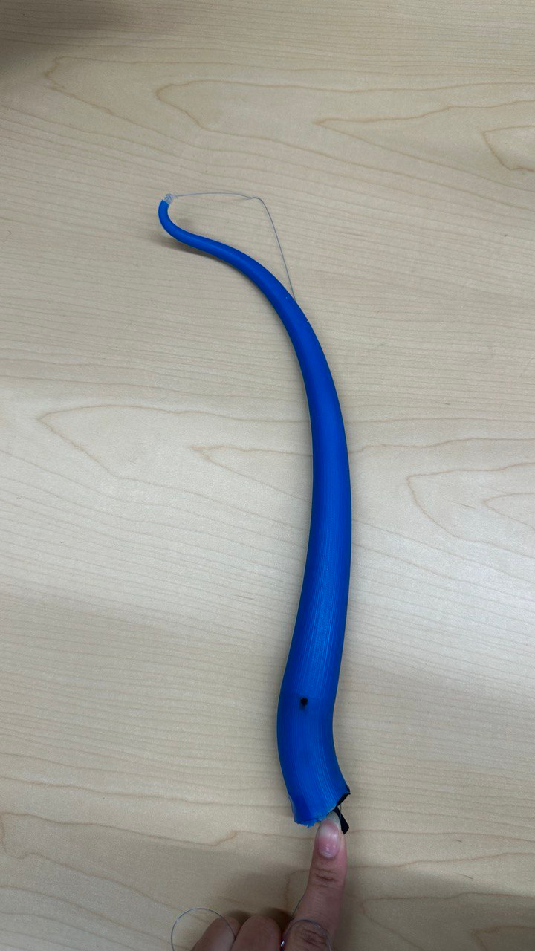
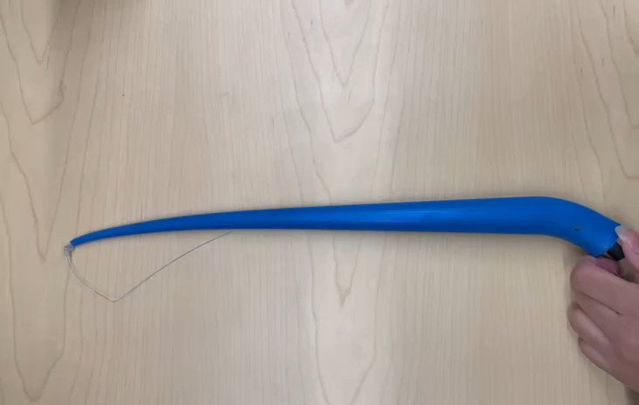
Flexible Soft Link
Notes:
Here you can see the actual flexible soft link i used for the project. Notice its flexibility and how it deforms during motion

Slide 6

Data Acquisition
DVS Event Video
Challenges
Balancing Noise Filtering and Link Detail’s Preservation
Missing or Incomplete Shape Detection
Notes:
The acquisition of high-quality data posed two major challenges. First, the noise in DVS video, particularly in the form of events, required filtering techniques. But, we needed to be careful to avoid losing important fine-grained detail about the link's shape during this noise reduction process. Secondly, reliably detecting the complete shape of the link – a continuously changing, flexible object that could bend, and twist proved its difficulty.

Slide 7





Pipeline Overview
01
02
03
04
05
Preprocessing
Motion Tracking
Contour Representation
Velocity Estimation
Visualization
Notes:
my approach involved a designed five-step pipeline. First, preprocessed the video to improve its quality and prepare it for analysis. Then, moved on to motion tracking, followed by contour representation. After this shape extraction, estimated velocities, and finally, generated visualizations of the results.

Slide 8

Preprocessing
Preprocessing Steps:
Adaptive Thresholding: Handles varying lighting conditions.
Gaussian Blur: Reduces noise while retaining edges.
Morphological Operations: Close gaps and remove noise (morphological close operation).
Importance:
Clean representation to help the subsequent edge detection and contour finding.
Notes:
The preprocessing step was crucial. I employed adaptive thresholding to handle varying lighting conditions, which is especially important in dynamic scenes. Next, Gaussian blurring helped reduce noise while preserving essential edge information. Finally, applied morphological operations to close small gaps and remove any remaining noise, producing a clean, high-quality image ready for the next stages.

Slide 9
Edge Detection and Contour Extraction
01
Edge Detection
Importance
02
Canny Edge Detection: Used to find boundaries.
Contour Extraction: Extract the edges to identify all points making up the link.
Basis or shape representation and velocity analysis.
Notes:
For shape extraction, i used the robust Canny edge detection algorithm, known for its ability to identify meaningful edges accurately. Following this, contour extraction precisely defined all points that define the link's boundary at any given frame. This detailed representation was essential for both accurate shape analysis and velocity estimations.

Slide 10



Noise Removal
Approach
Based on the density of points (DBSCAN parameters: eps and min_samples).
DBSCAN Clustering
Result
Only significant points representing the link structure are retained.
Removes noise and outlier points.
Notes:
Further noise reduction was achieved using Density-Based Spatial Clustering of Applications with Noise (DBSCAN). This algorithm is incredibly powerful at identifying clusters of data points and effectively filtering out outliers. The algorithm’s parameters were carefully tuned to accurately identify the link’s structure whilst rejecting any outlier points.

Slide 11
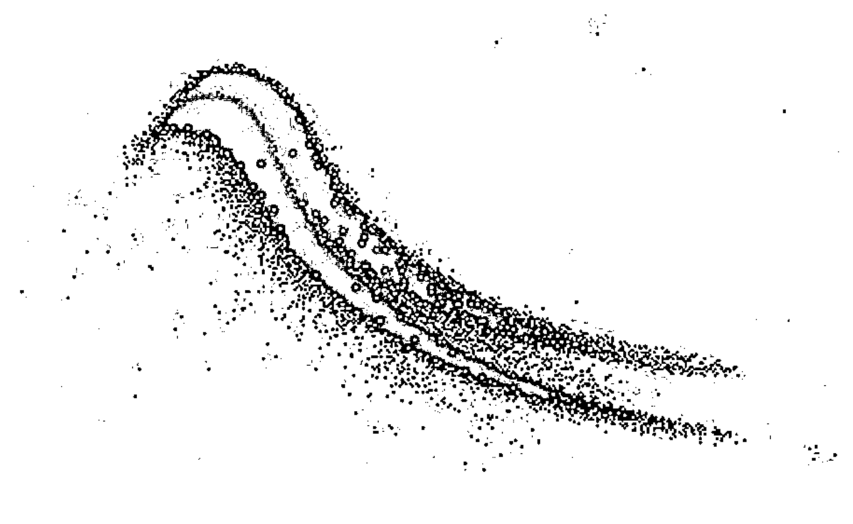
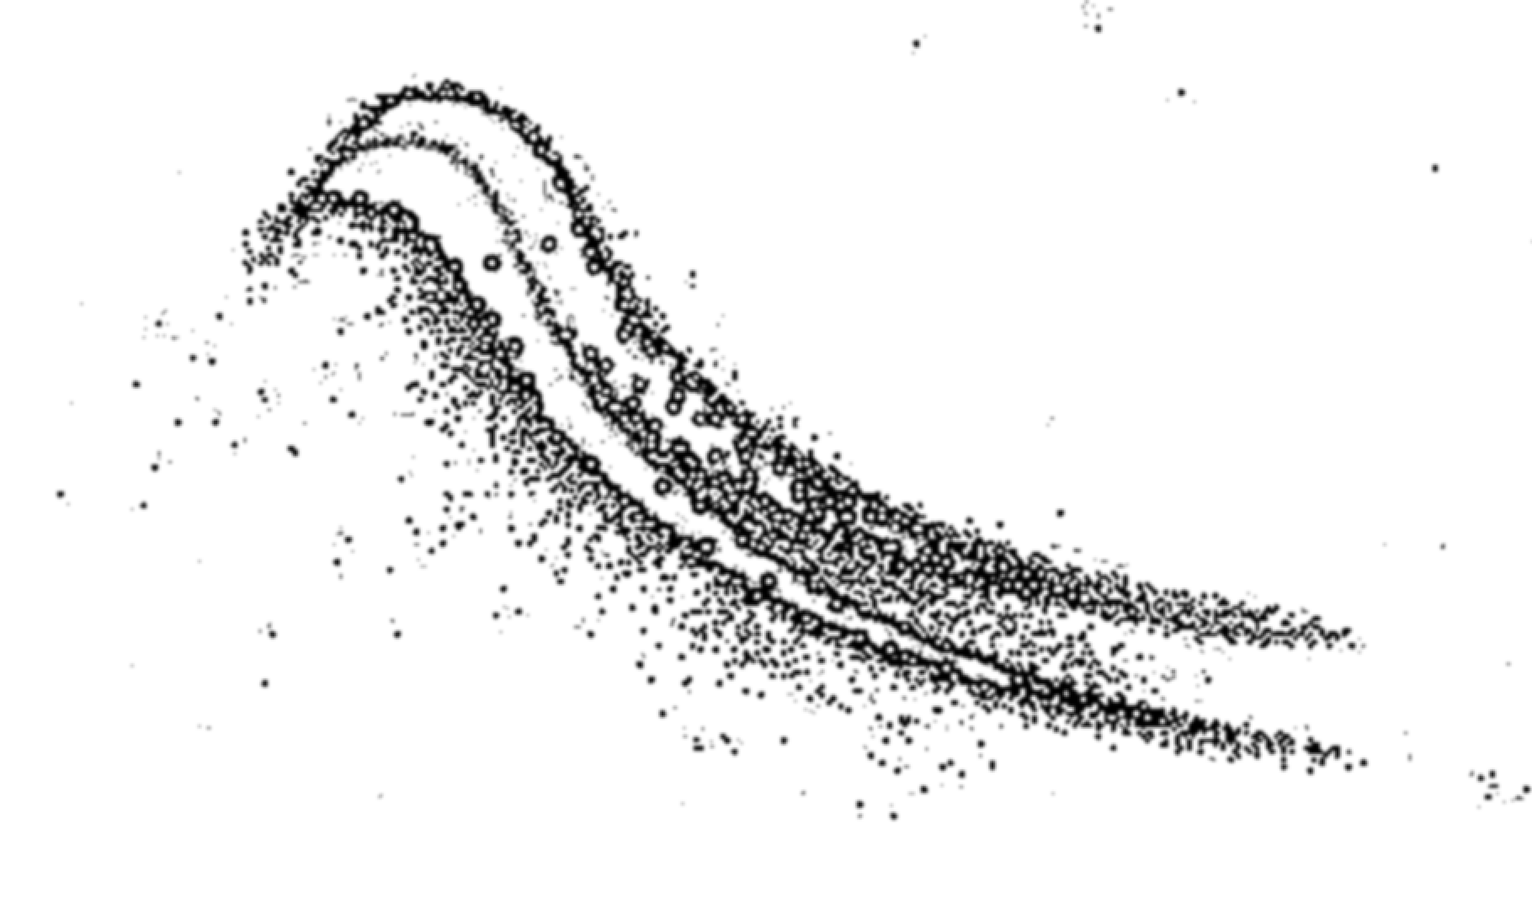
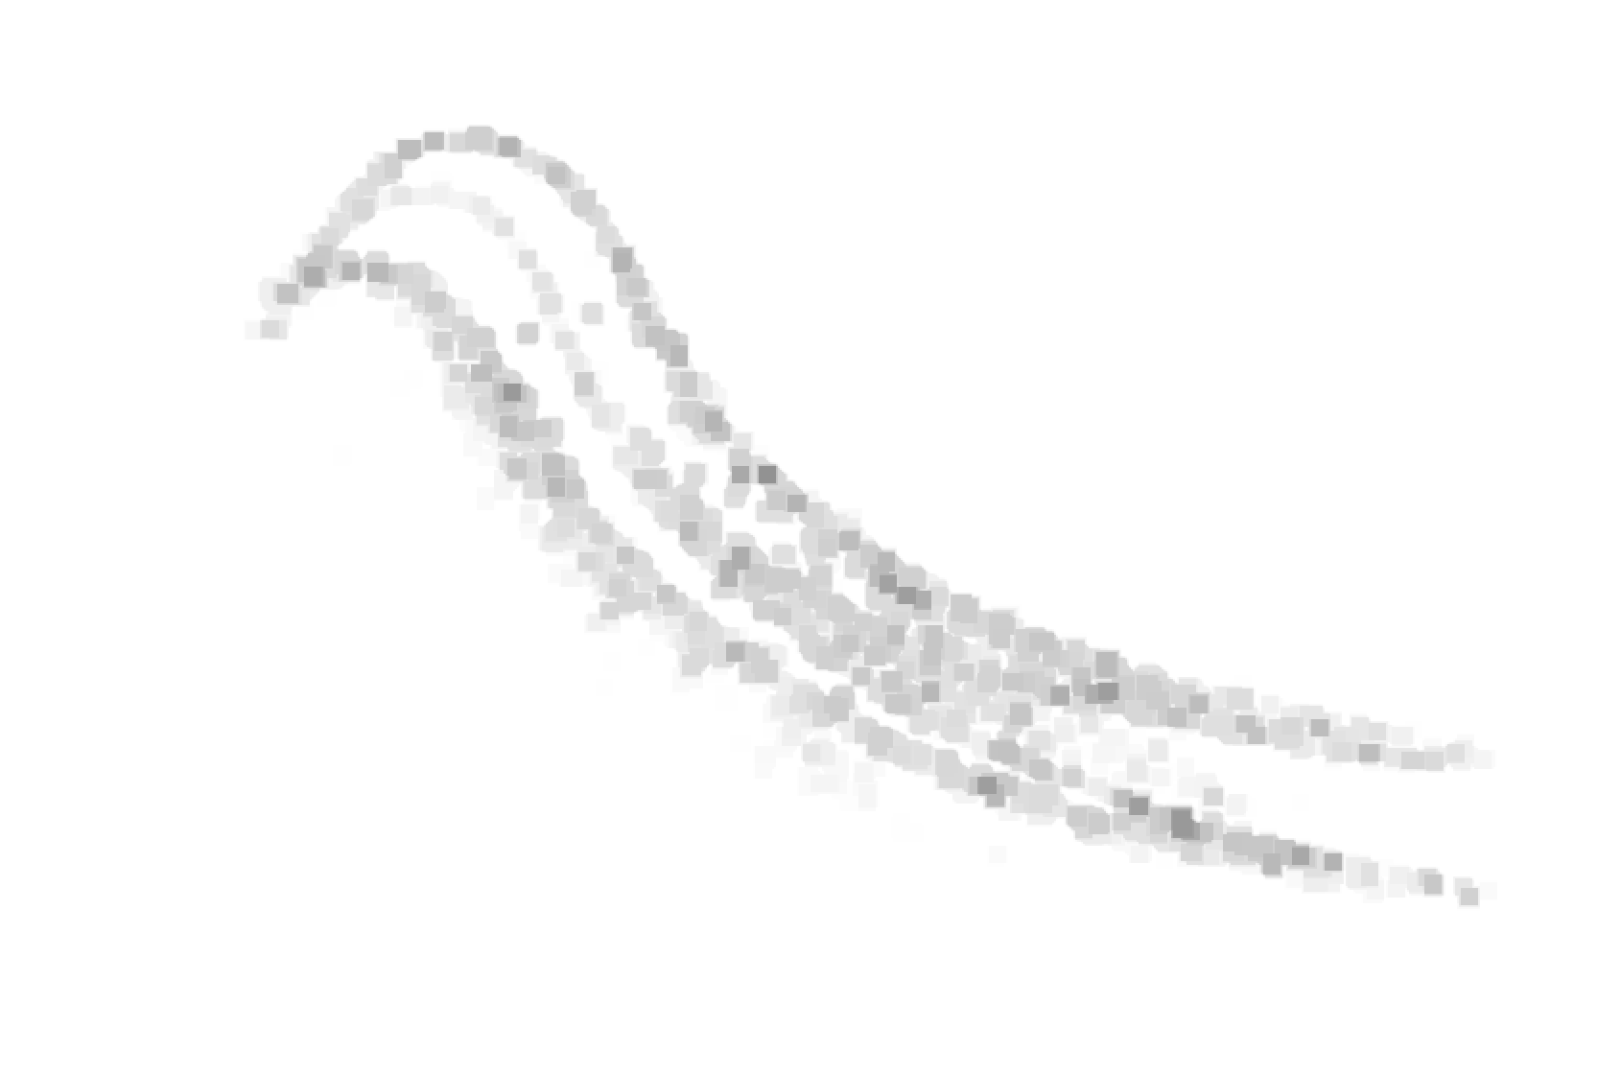
Noise Removal
Adaptive Threshold
Gaussian Blur
Morphological operations
Notes:
This slide visualizes the result of the noise removal steps. As you can see, the raw, noisy data is progressively refined until we obtain a very clean representation, significantly improving the accuracy of subsequent steps.

Slide 12
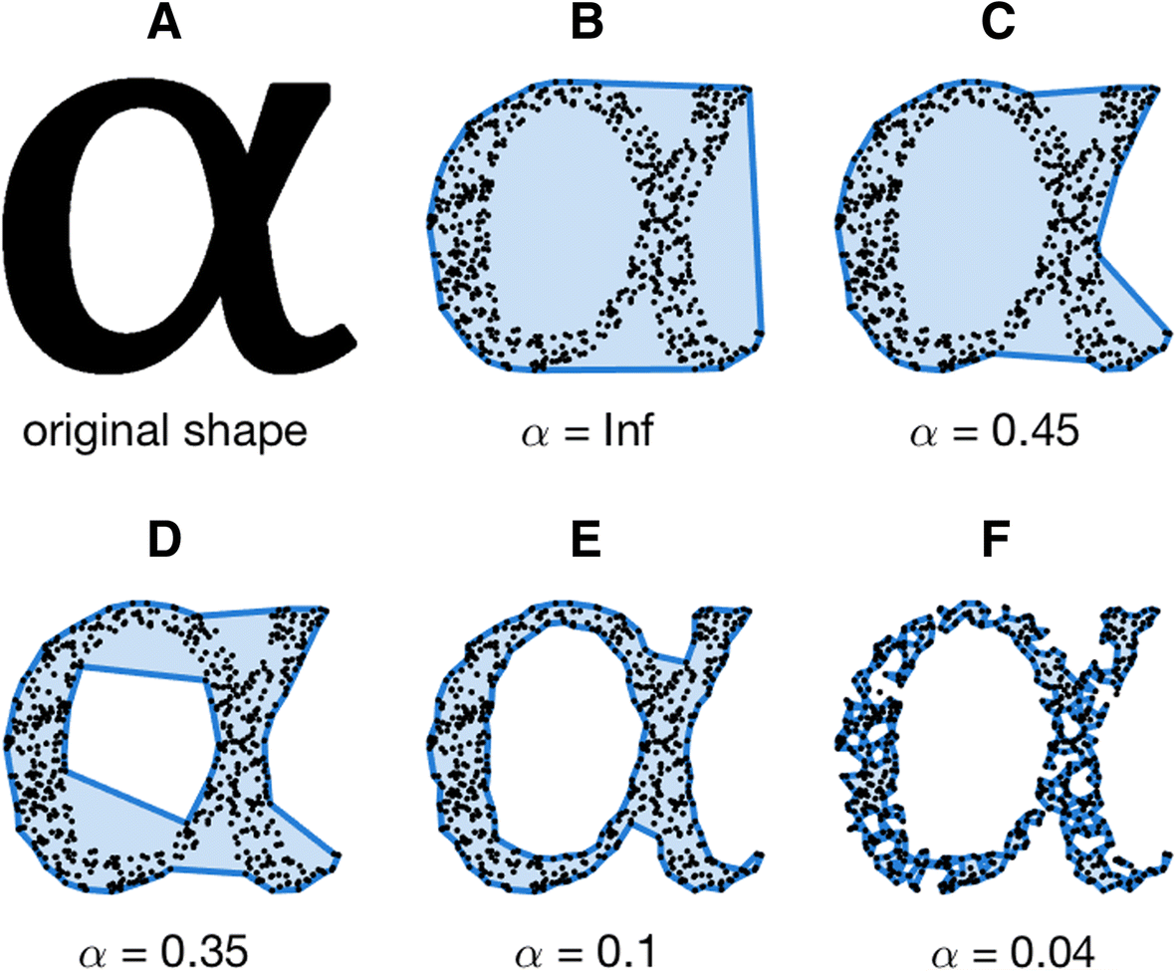
Alpha Shape Representation
Alpha Shapes:
Generate a smooth boundary representation of the link. Handle cases where the link forms concave shapes.
Notes:
Alpha shapes were crucial in representing the link's dynamic contour. This technique generates a smooth, continuous boundary representation, even in regions where the link bends and forms concave shapes – a problem commonly encountered with traditional methods. The alpha parameter allows us to fine-tune the level of detail in our representation.

Slide 13
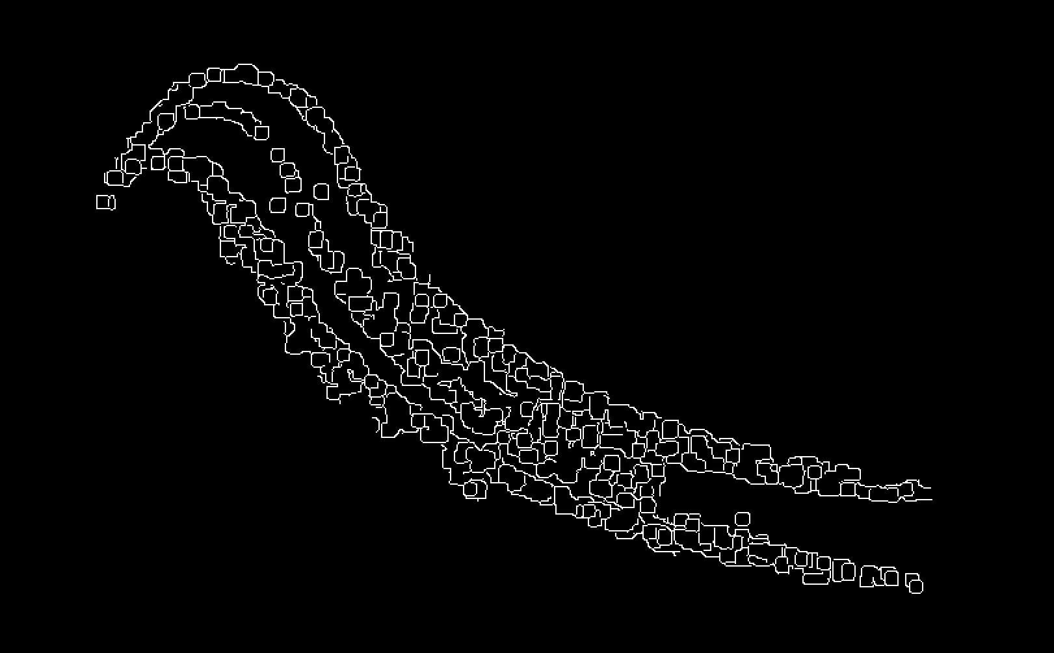
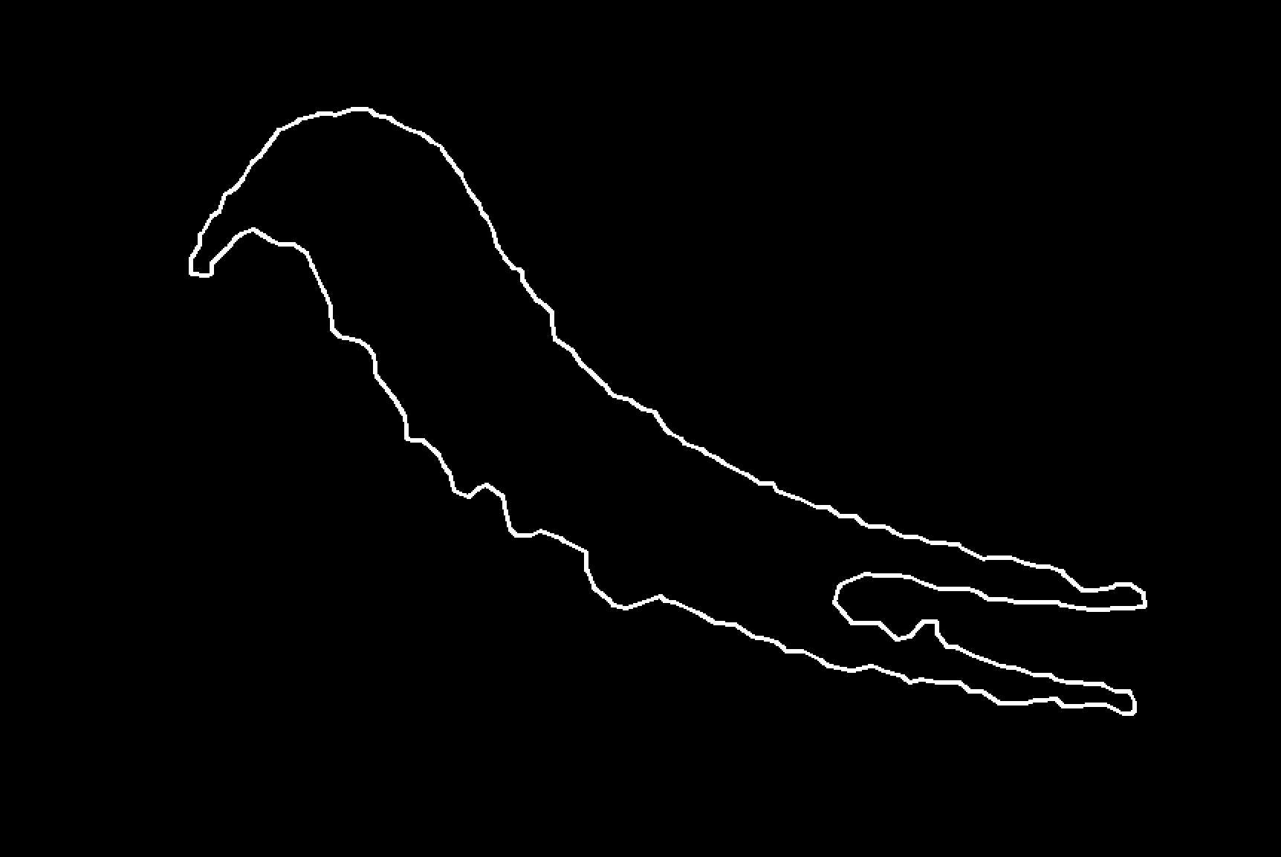
Alpha Shape Representation
Canny edge detection
Alpha shape
Notes:
Here, you witness the transformation of alpha shapes. We move from raw edge data to a streamlined representation of the link's boundary, highlighting the algorithm’s ability to handle complex shapes.

Slide 14
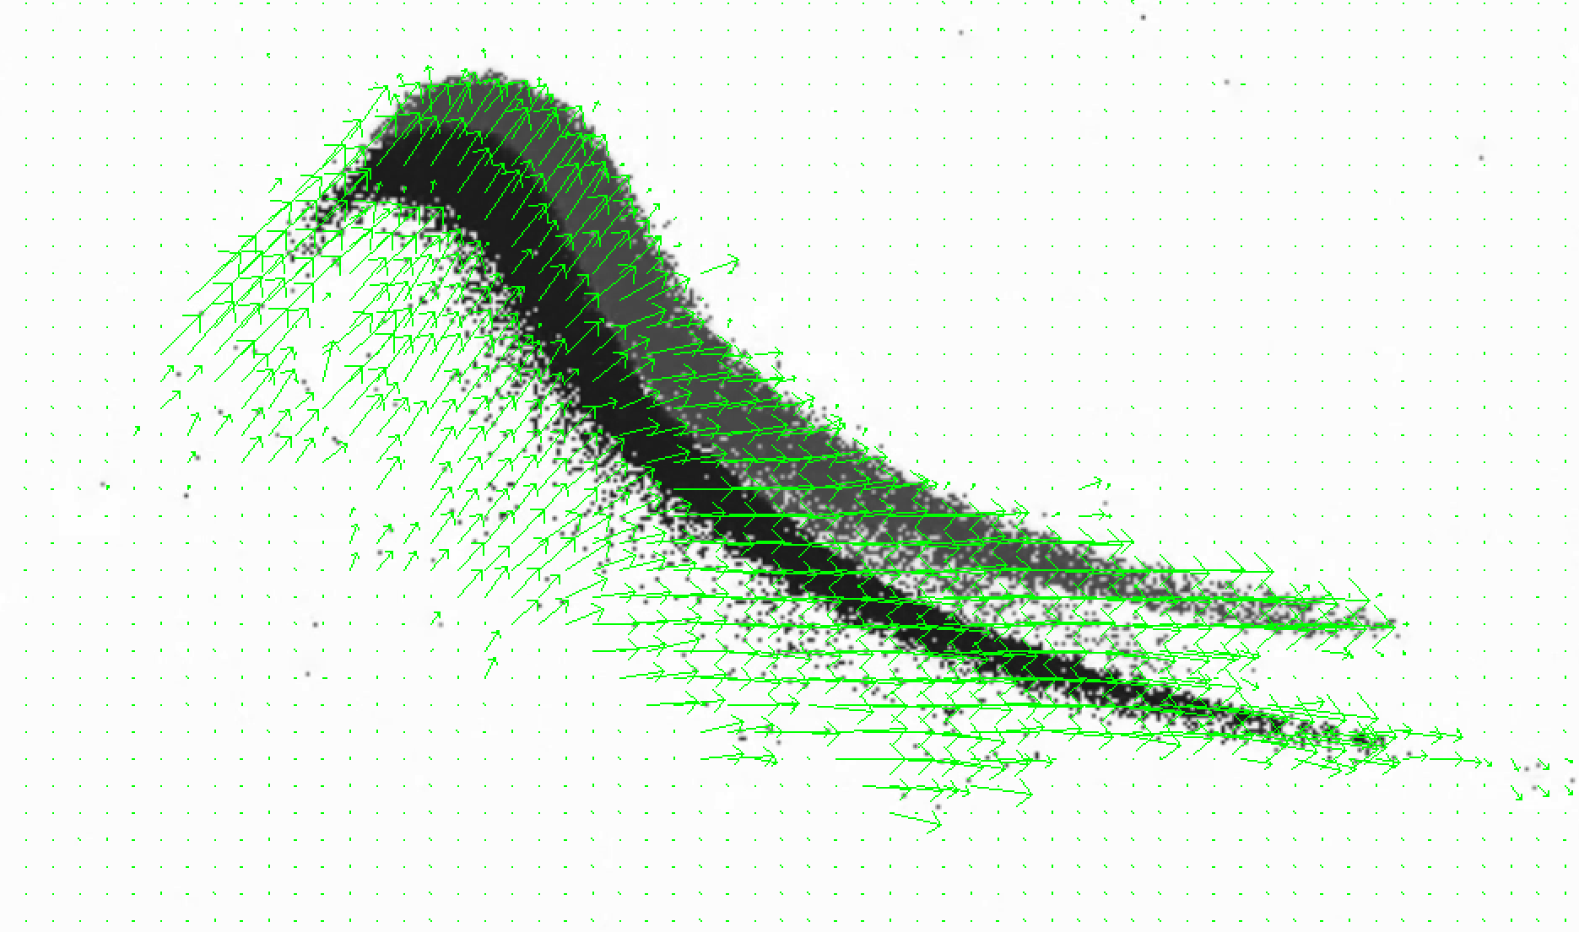
Motion Tracking with Optical Flow
Optical Flow:
Farneback Optical Flow for dense flow estimation between frames.
Purpose:
Track the general movement of the link between frames.
Helps determine the displacement of key points.
Notes:
To track the link's motion, I employed Farneback Optical Flow, a powerful technique for estimating the dense flow field between consecutive frames. This enabled us to track the overall movement of the link while precisely identifying the displacement of individual points along its length.

Slide 15


Missing Data Handling with Kalman Filter
Kalman Filter
01
Predicts the movement when the link is not detected clearly.
Smoothens the tracking by accounting for noisy detections.
Importance
02
Handles missed detections to provide consistent motion data.
Notes:
Even with robust algorithms, some data points might be unreliable or missing entirely. To address this, I integrated a Kalman filter. The Kalman filter predicts the link’s movement, compensating for missing data and smoothing out noisy detections, thereby enhancing the consistency and accuracy of our tracking.

Slide 16
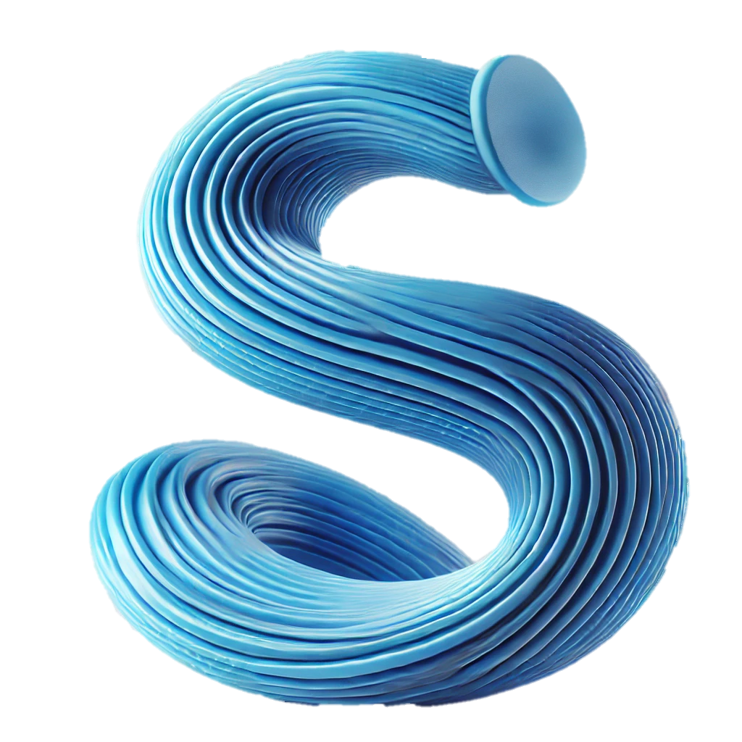

Velocity Estimation
Detect Shape
Select Points.
Pixel-to-Meter Conversion.
Optical Flow for Displacement.
Calculate Velocity:
$$v=\frac{\sqrt{{\left(dx\right)}^{2}+{\left(dy\right)}^{2}}}{∆t}$$
​​
Notes:
The velocity estimation process was quite involved. began by detecting the shape and selecting key points along its contour. then converted pixel displacements to real-world distances, which required precise calibration. Optical flow then provided displacement measurements between consecutive frames. Finally, calculated velocity using the simple yet effective formula you see on this slide.

Slide 17
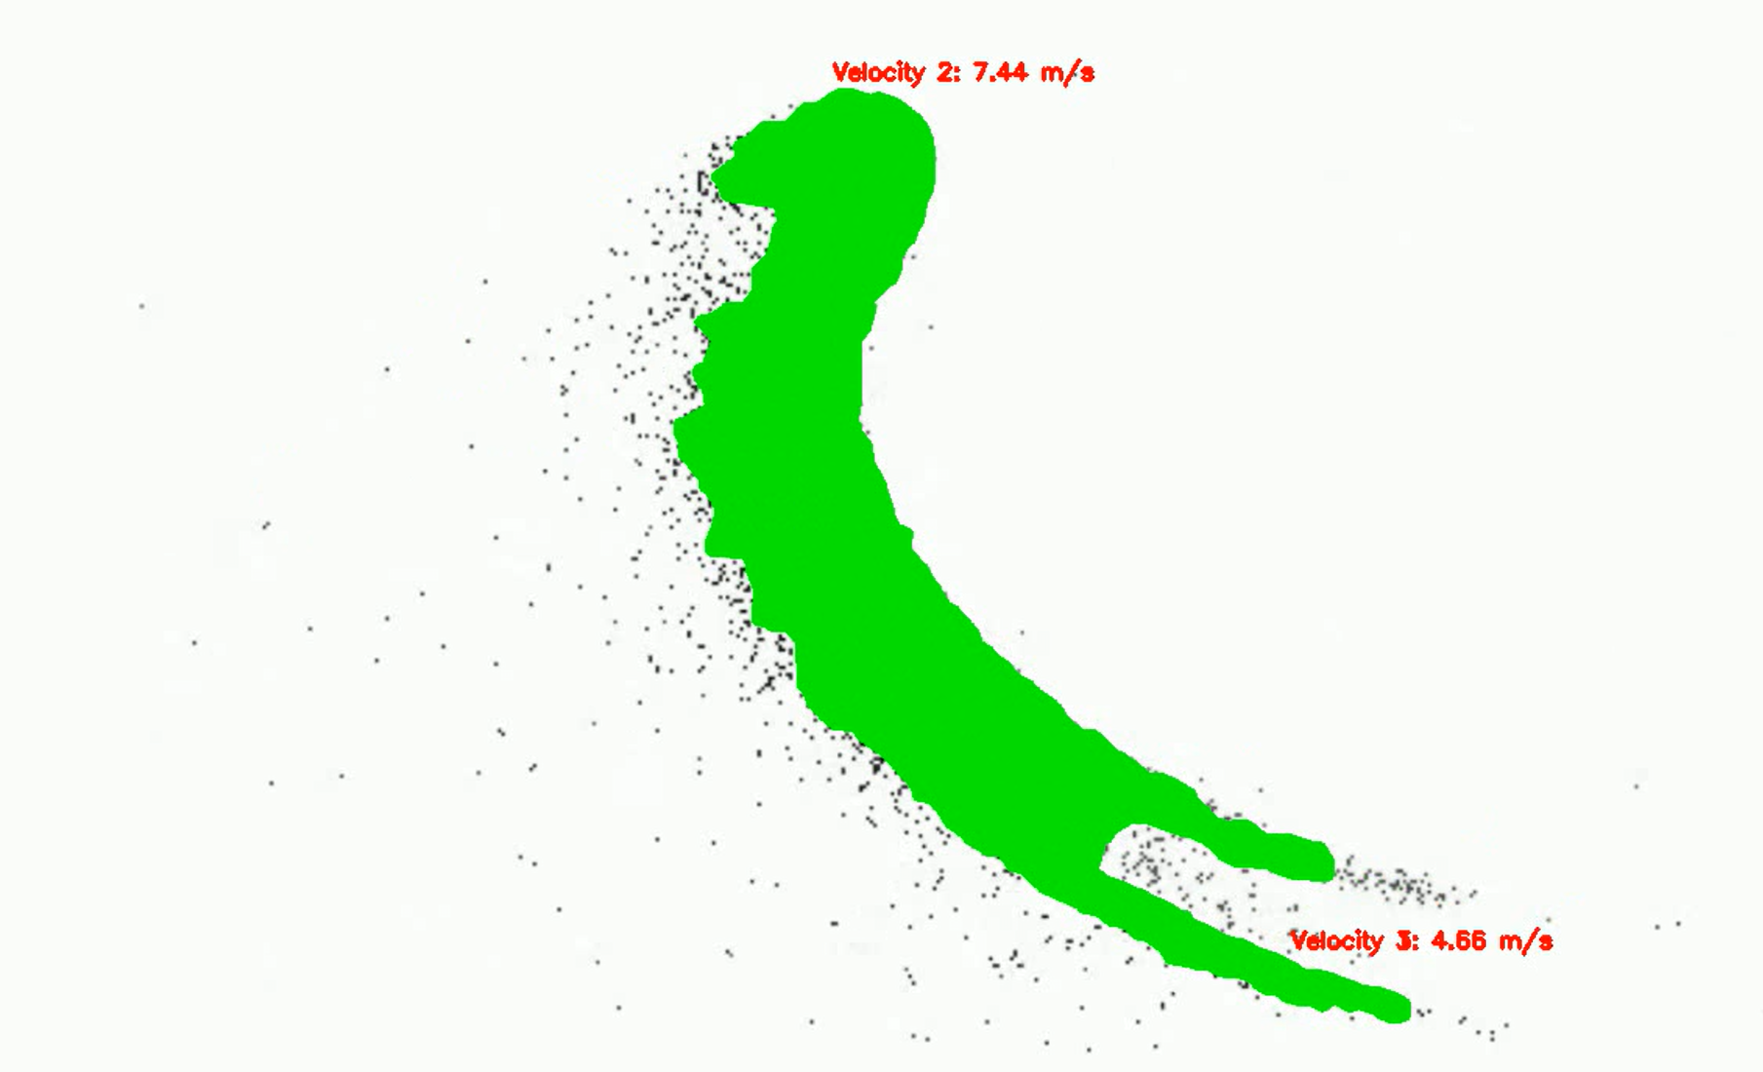
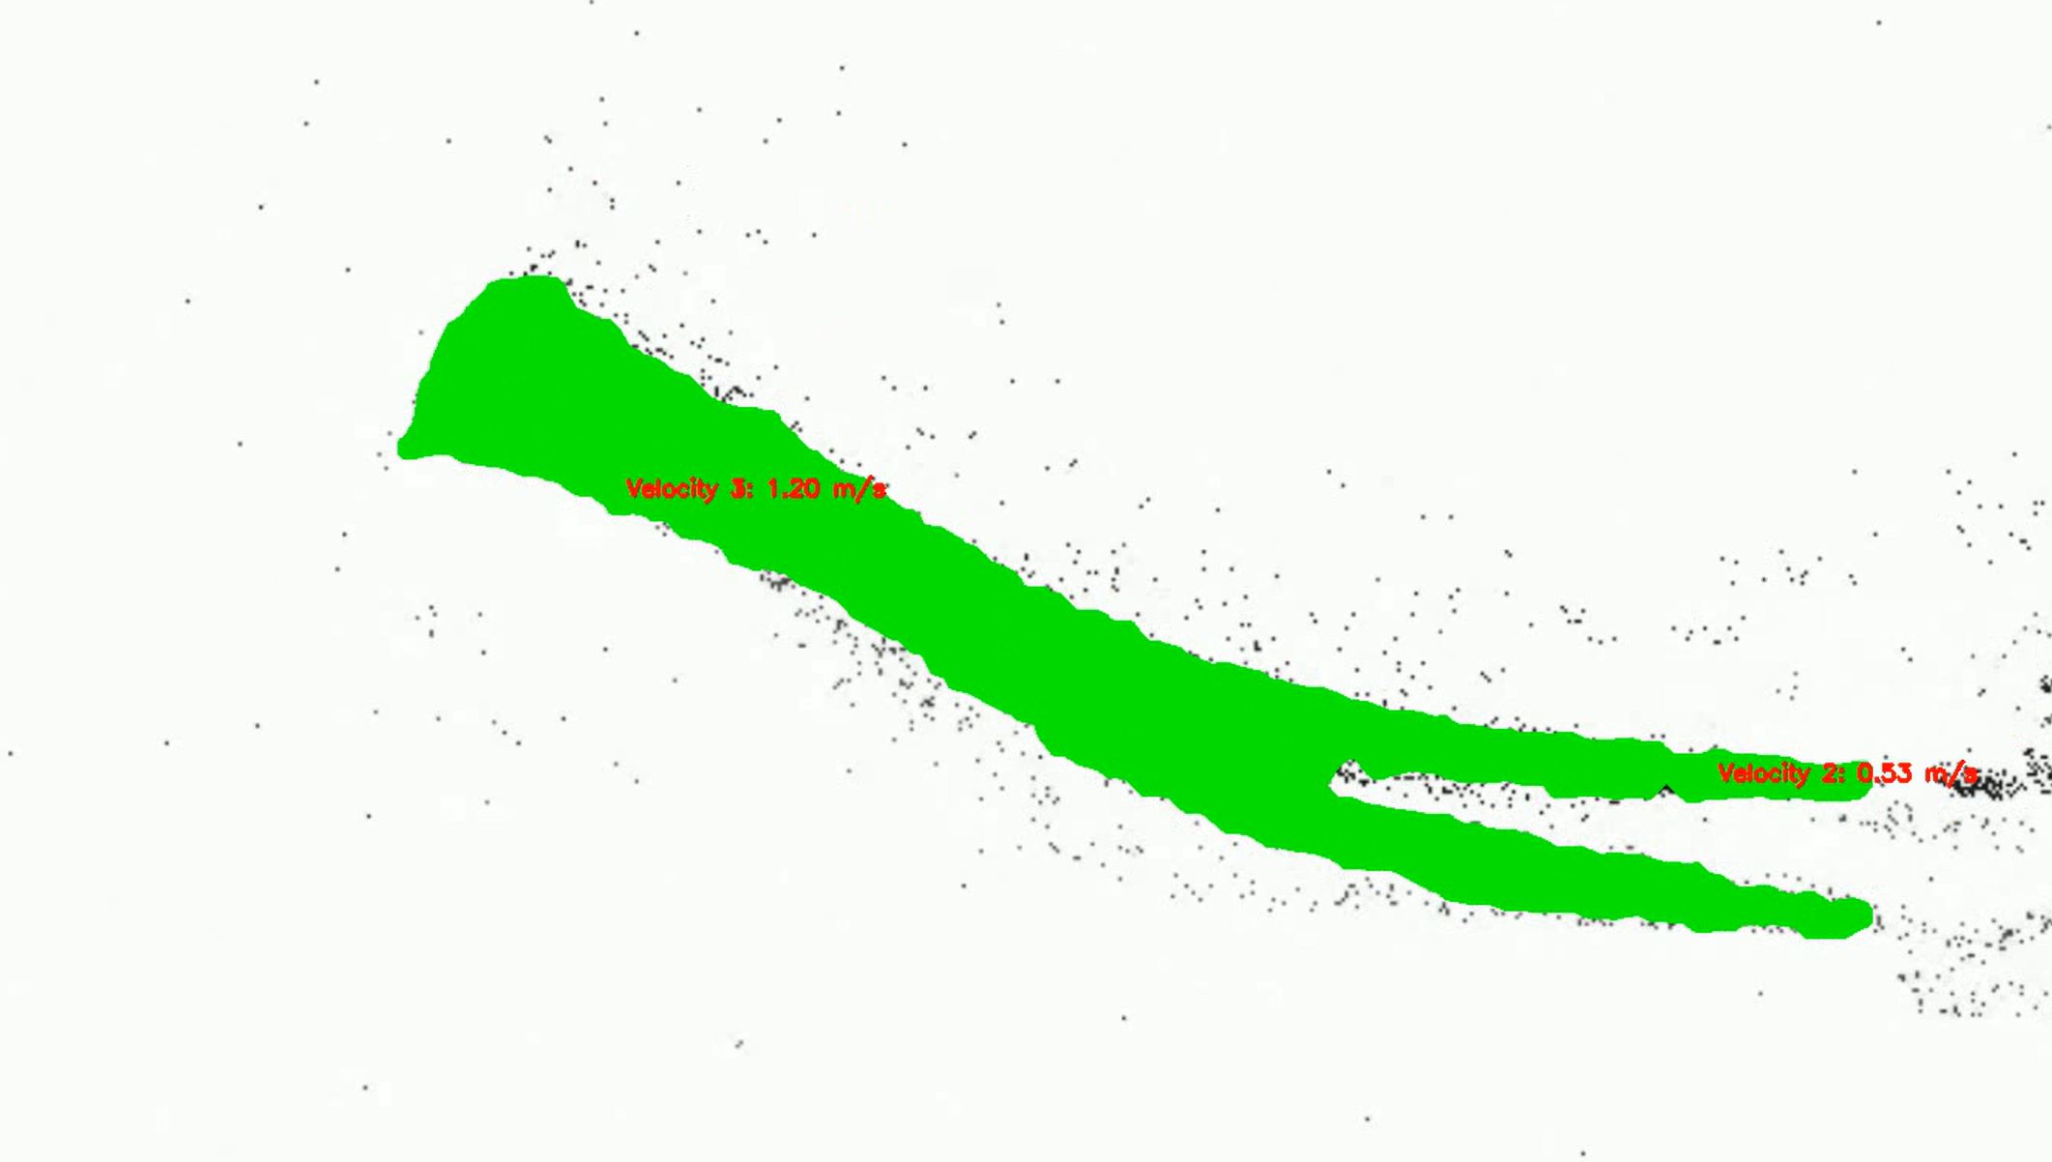
Results
Contour Representation and Velocity Estimation
Notes:
This slide present the key results: the accurate contour representation of the link during its dynamic motion, overlaid with velocity magnitude at key points., demonstrating the complex movements of the flexible link.

Slide 18

Results

Slide 19



Performance Evaluation
Promising Ability
Challenging Conditions
Consistent Visibility
Qualitative
Evaluation
Notes:
"The evaluation of our flexible link tracking algorithm presents unique challenges due to inconsistencies in the DVS dataset. Specifically, the link is not consistently visible across all frames, preventing a traditional quantitative evaluation based on ground truth. To address this, I conducted a qualitative performance assessment:
Consistent Visibility: When the link is clearly visible and the motion is relatively smooth, the algorithm accurately tracks its position and velocity. This is shown in the sample video frames shown earlier.
Challenging Conditions: In frames with poor visibility, the algorithm's performance is understandably reduced. This is a consequence of the dataset itself, not a limitation of the algorithm. Overall: The algorithm displays a promising ability to accurately track the link, highlighting its resilience to moderate levels of noise and variability in lighting when the link is visible, yet is naturally impacted by the limitations of the dataset itself."

Slide 20
Conclusion
Effective Velocity Estimation: The pipeline successfully tracks and estimates the velocity of the soft robotic link using optical flow combined with Kalman filtering.
Link Detection and Tracking: The system demonstrates strong performance in detecting the link and estimating its velocity when the link is fully visible and the motion is consistent.
Notes:
In summary, this research presented a pipeline for the accurate tracking and velocity estimation of flexible links from DVS video. The system demonstrates strong performance under conditions of consistent motion and good visibility. We believe our methodology is reliable and achieved the goals of this project.

Slide 21
Future Work
Improvement: Incorporating more advanced methods like RAFT optical flow or integrating physics-based simulations could improve accuracy and robustness in handling dynamic deformations and noise.
Future Enhancements: Future work can focus on enhancing detection reliability, improving optical flow techniques, and exploring the use of machine learning for dynamic link modeling and tracking.
Notes:
Future work will explore more advanced optical flow techniques like RAFT, integrate physics-based simulations for improved accuracy, and focus on enhancing the robustness of our detection methods. We also plan to investigate the application of machine learning algorithms for more sophisticated and adaptive dynamic link modeling.

